Slide 1
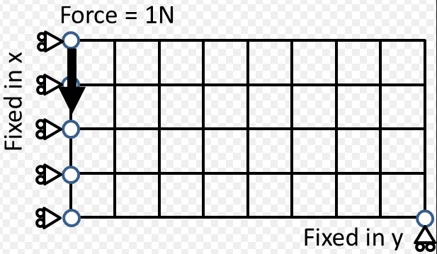
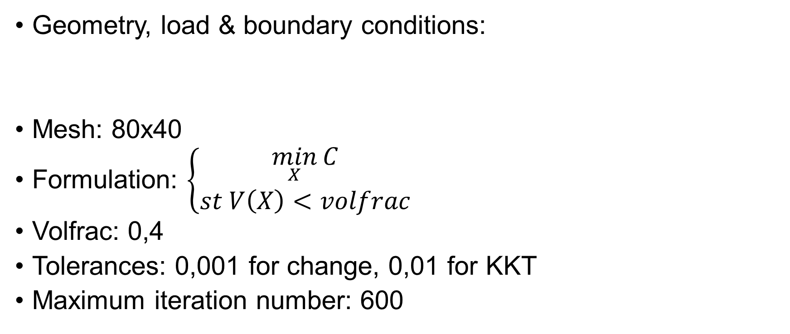
MBB beam
Geometry, load & boundary conditions:
Mesh: 80x40
Formulation: $\left\{\begin{matrix}\min_{X}{C} \\ st V\left(X\right)<volfrac\end{matrix}\right.$
Volfrac: 0,4
Tolerances: 0,001 for change, 0,01 for KKT
Maximum iteration number: 600
DH=1
DW=2

